Slide 1
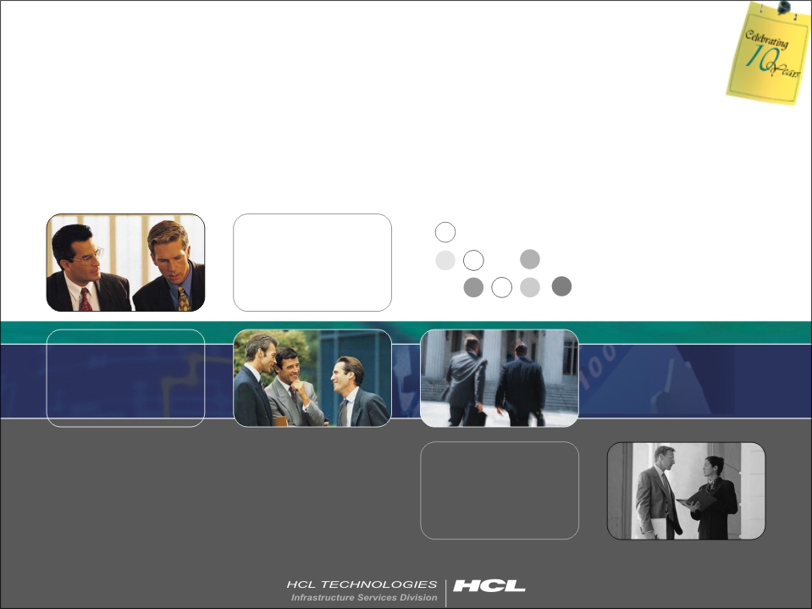
File System hierarchy in HP-UNIX

Slide 2
What is File System?
UNIX files and directories are arranged in a systematic way.
The root directory is represented by the slash symbol (/)
It does not mean the actual physical format of the disk drive but shows only logical arrangement.
Every directory contains a particular set of files related to some defined purpose or task.
For example, all files in the /etc directory are related to some sort of system configuration task

Slide 3
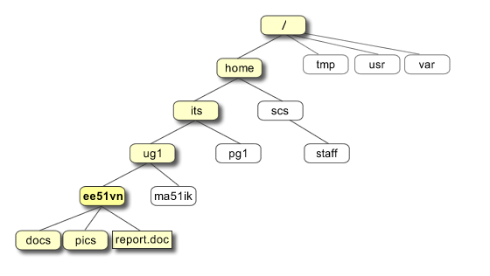
Layout of a file system(eg.)

Slide 4
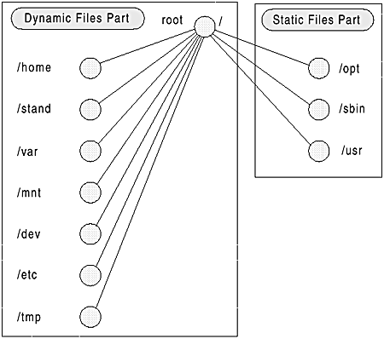
Types of file system.

Slide 5
Static and Dynamic Files
STATIC FILES:
Static files and directories contain information that usually does not change after system installation
The files that fall into this category are executable files, libraries, applications, and so on. EG: /sbin, /usr, and the application directories under /opt.
DYNAMIC FILES:
The dynamic files are those that are found in other directories like the /var directory, which holds most of the log files.
You can place temporary files in the /tmp directory. Most of the applications also put their temporary files in the /var, /tmp directory and it continuously changes.

Slide 6
Overview of File Systems.
The Root Directory ( / )
All of the file system is viewed with reference to the root directory
This is the top-level directory in the tree structure .
It is represented by a slash character (/)
The Device Directory (/dev)
The device directory contains all of the device files.
Device files are used to represent devices attached to the system.
This is used to group device files in a more logical way.

Slide 7
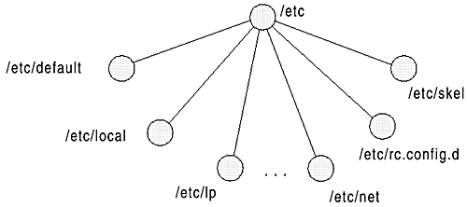
Overview of File Systems(contd..)
The /etc Directory
All of the system configuration files are placed in this directory.
The files here control system startup and shutdown procedures as well as the startup and shutdown of server and daemon processes
It also contains configuration files for applications installed on the HP-UX system.

Slide 8
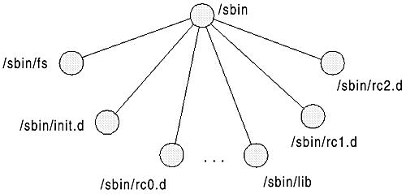
Overview of File Systems(contd..)
The Home Directory (/home)
Traditionally, this directory contains the home directories of all system users.
Under the home directory of each user is located user-related configuration files
The System Binary Directory (/sbin)
This directory contains executable files needed at boot time.

Slide 9
Overview of File Systems(contd..)
The /stand Directory
This is the directory where the HP-UX kernel is kept
The kernel file is /stand/vmunix and the configuration file is /stand/system
It also contains the /stand/build directory used to rebuild the new kernel
The Application Directory (/opt)
The /opt directory is used for installing applications on an HP-UX system
The Temporary File Directory (/tmp)
Temporary files are placed in this directory and are deleted from time to time.

Slide 10
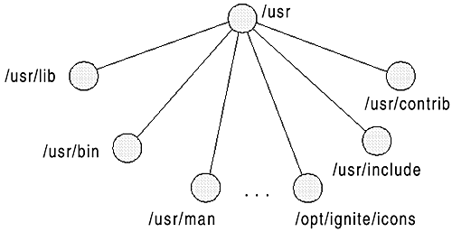
Overview of File Systems(contd..)
The /usr Directory
This is an important directory, as most of the HP-UX system files are placed here.
Most important file types are user-related commands, libraries, documentation and manual pages

Slide 11
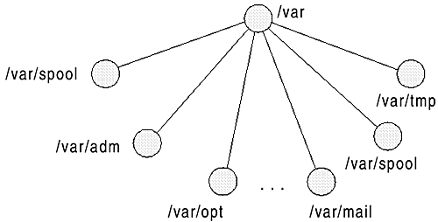
Overview of File Systems(contd..)
The Variable Files Directory (/var)
This directory contains basically three types of files: log files, spool files, and temporary files created by applications

